Slide 1
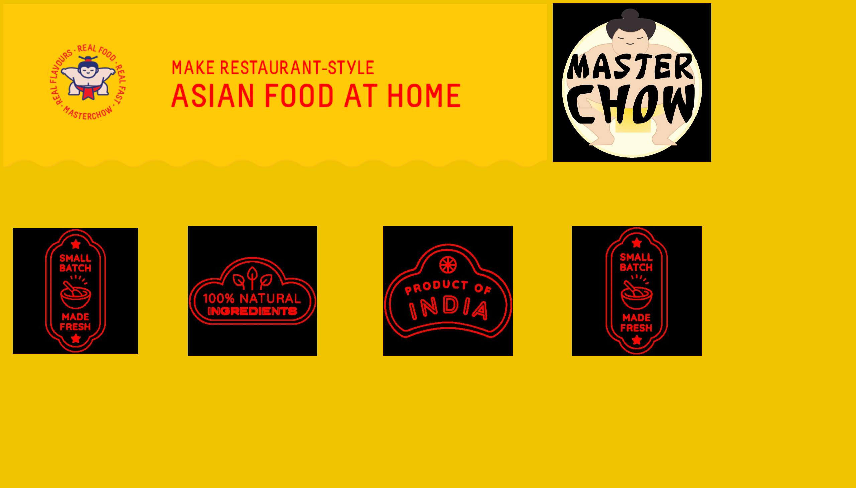
Masterchow
Notes:
image
No alt text provided
image
No alt text provided
image
No alt text provided
image
No alt text provided
image
No alt text provided
image
No alt text provided

Slide 2
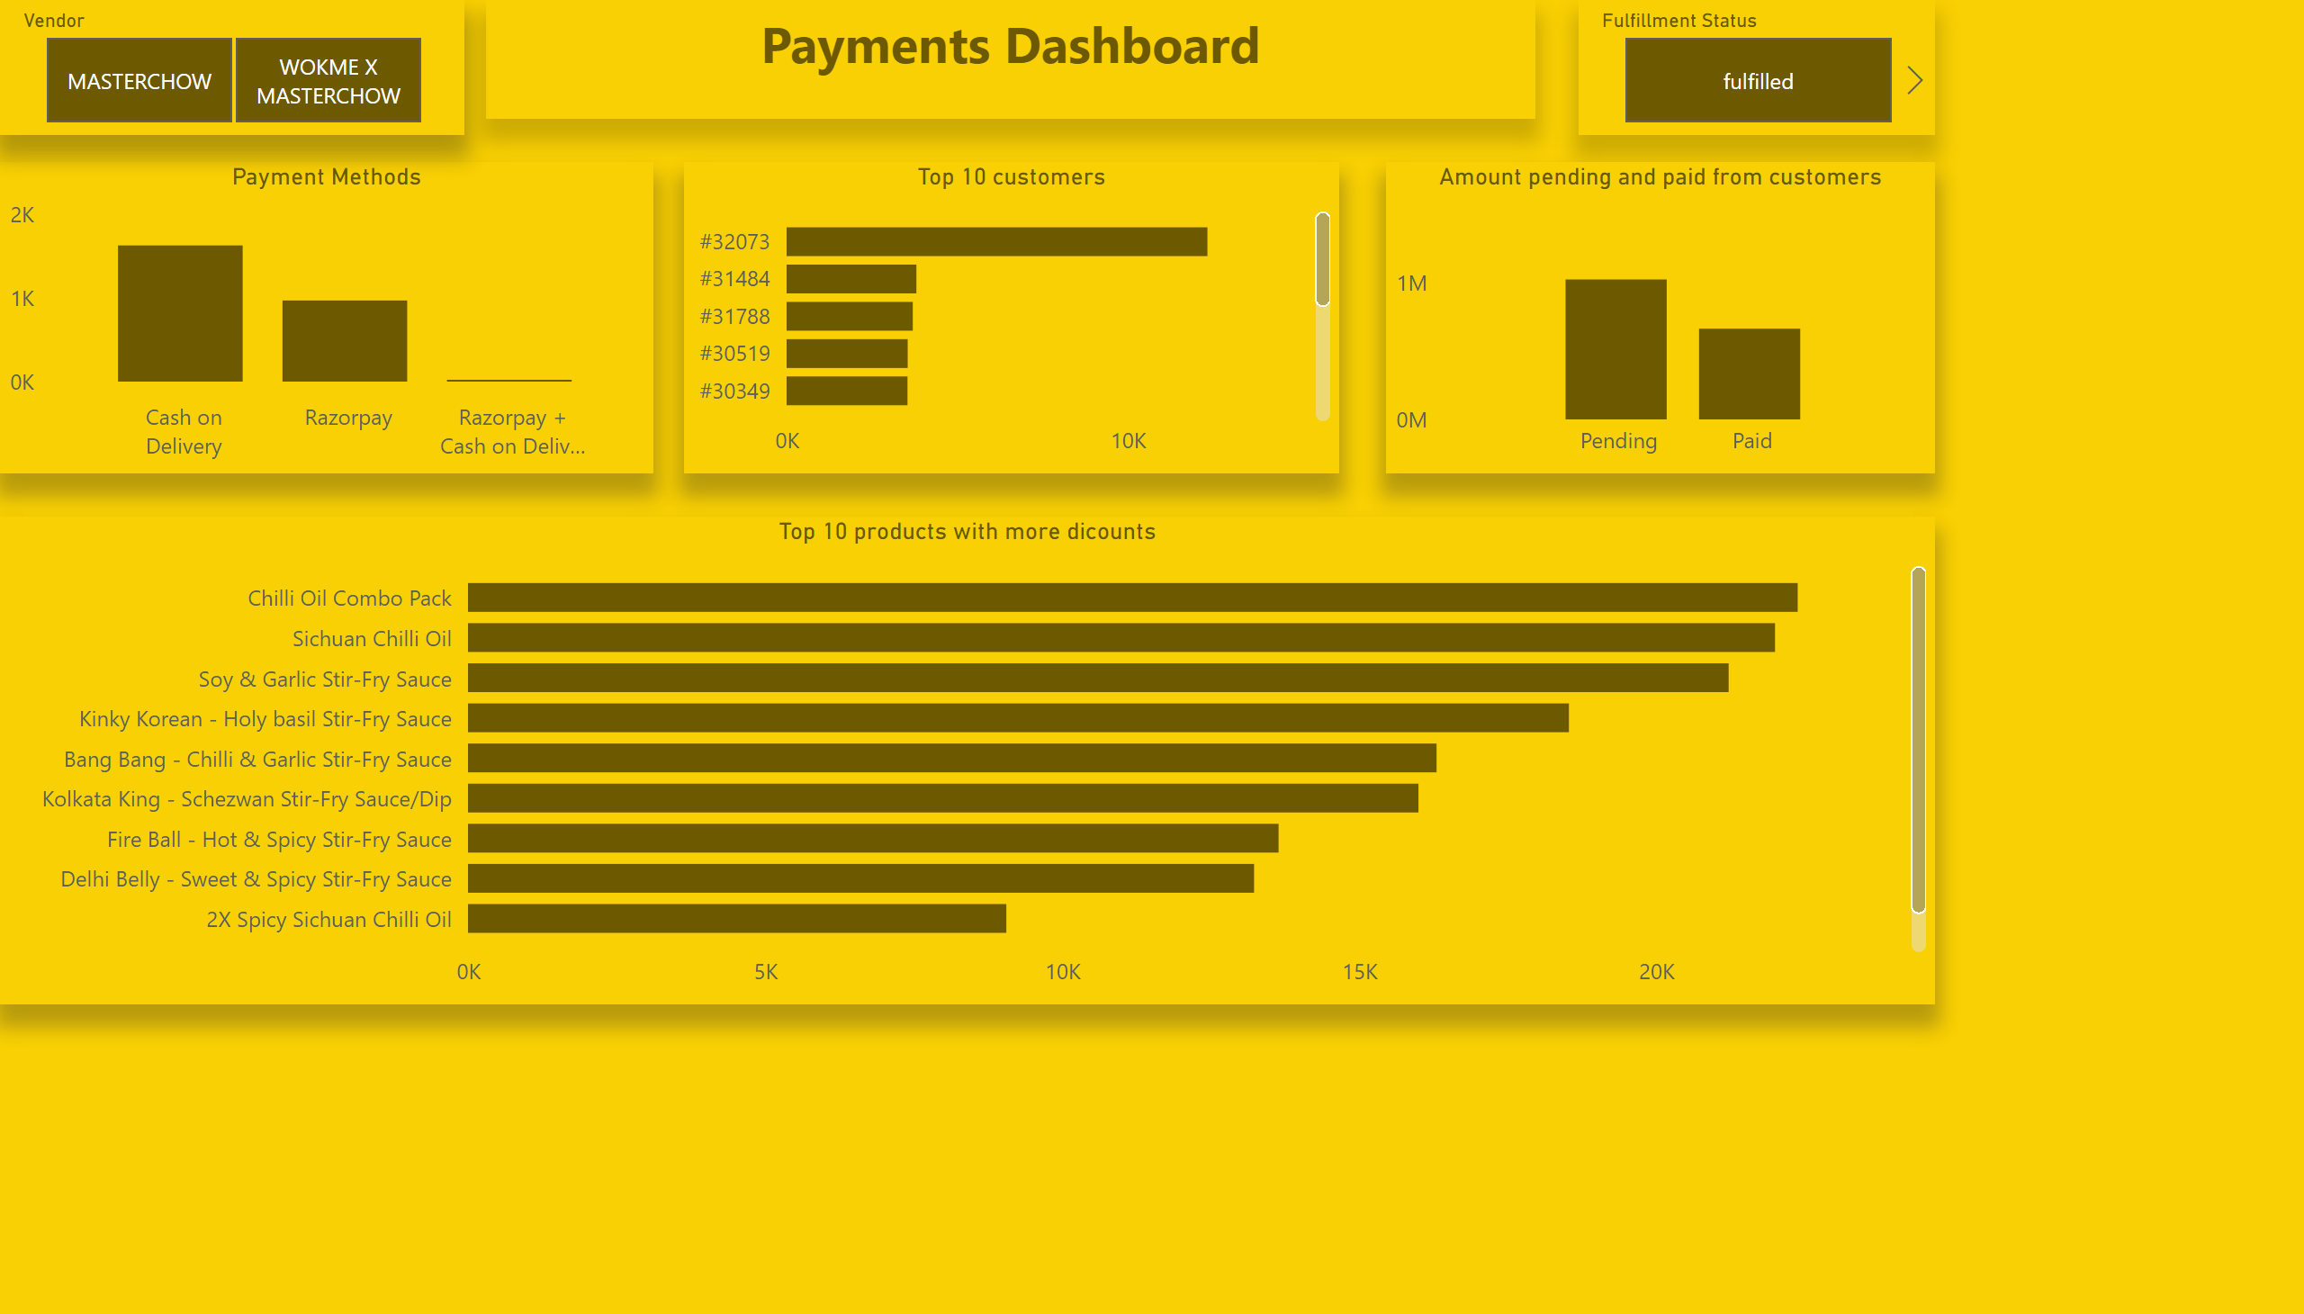
Payment Dashboard
Notes:
textbox
No alt text provided
Payment Methods
No alt text provided
slicer
No alt text provided
slicer
No alt text provided
Top 10 products with more dicounts
No alt text provided
Amount pending and paid from customers
No alt text provided
Top 10 customers
No alt text provided

Slide 3
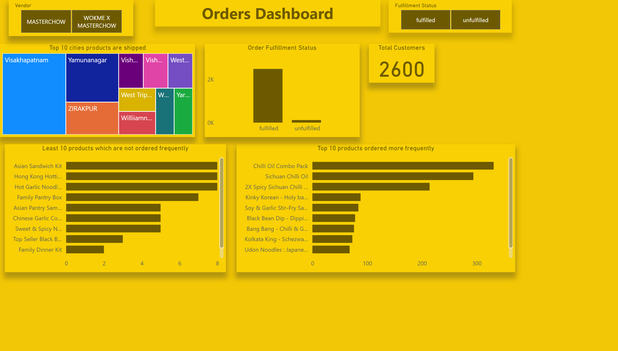
Orders Dashboard
Notes:
Top 10 products ordered more frequently
No alt text provided
Order Fulfillment Status
No alt text provided
Top 10 cities products are shipped
No alt text provided
textbox
No alt text provided
slicer
No alt text provided
slicer
No alt text provided
Total Customers
No alt text provided
Least 10 products which are not ordered frequently
No alt text provided

Slide 4
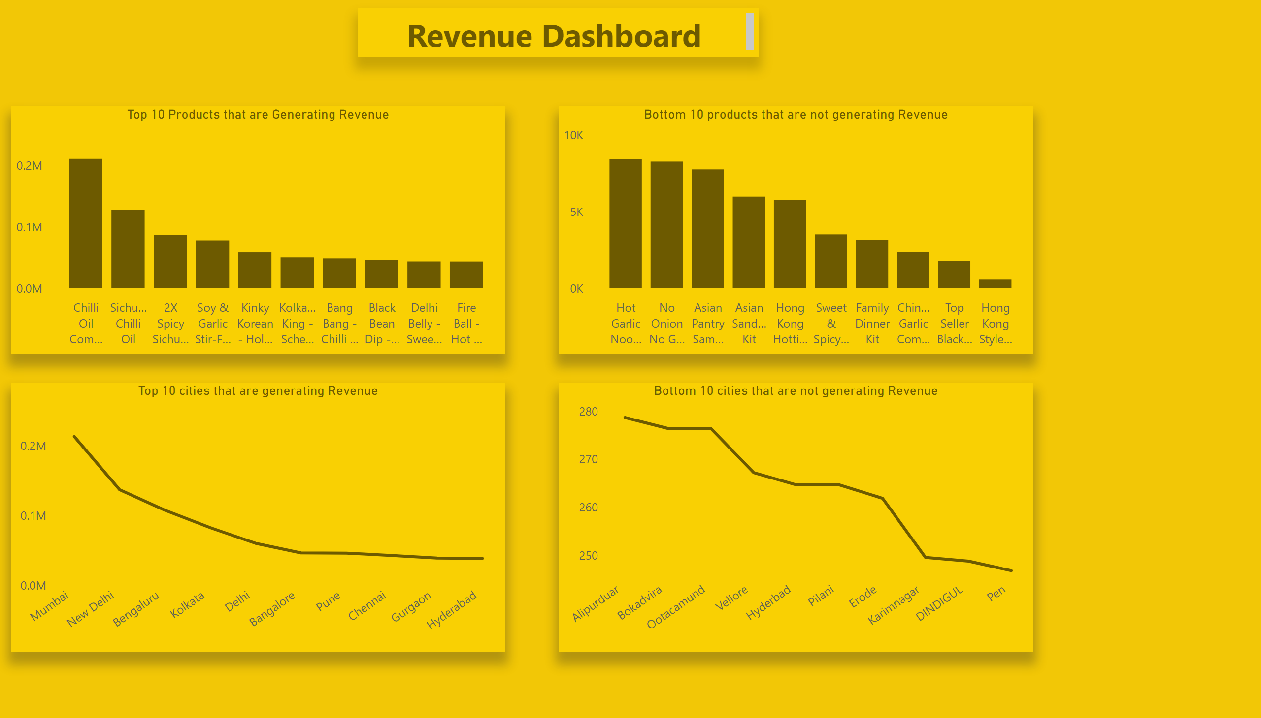
Revenue Dashboard
Notes:
Top 10 cities that are generating Revenue
No alt text provided
Top 10 Products that are Generating Revenue
No alt text provided
textbox
No alt text provided
Bottom 10 products that are not generating Revenue
No alt text provided
Bottom 10 cities that are not generating Revenue
No alt text provided

